Slide 1
LightGBM (Light Gradient Boosting Machine)

Slide 2
LightGBM, developed by Microsoft, is an efficient and scalable implementation of gradient boosting.
It is particularly optimized for large datasets and handles categorical features effectively.

Slide 3
Key Features
Histogram-Based Learning: Uses a histogram-based algorithm, which speeds up training and reduces memory usage.
Leaf-Wise Growth Strategy: Unlike traditional level-wise tree growth, LightGBM grows trees leaf-wise, leading to better accuracy and efficiency.
GPU Acceleration: Supports GPU training, making it significantly faster.

Slide 4
Handles Large Datasets: Optimized for large datasets with millions of rows.
Efficient Handling of Missing Values: Can handle missing values without requiring explicit imputation.
Supports Parallel and Distributed Training: Enhances speed when working with big data.

Slide 5
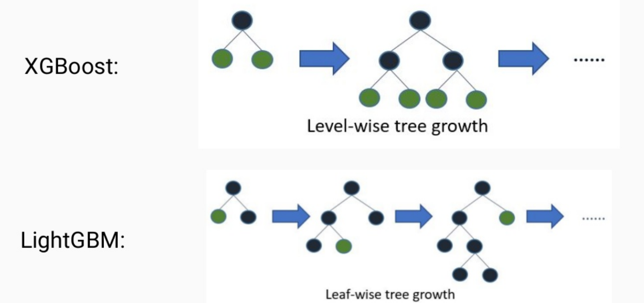

Slide 6
Histogram-Based Binning
Convert Continuous Values to Bins
Suppose we have a feature Age with values:
[22, 24, 29, 35, 40, 50, 55, 60, 65]
Instead of storing these exact values, LightGBM creates bins like:
Bin 1: 20–30 → (22, 24, 29)
Bin 2: 30–40 → (35, 40)
Bin 3: 40–50 → (50)
Bin 4: 50–60 → (55, 60)
Bin 5: 60+ → (65)

Slide 7
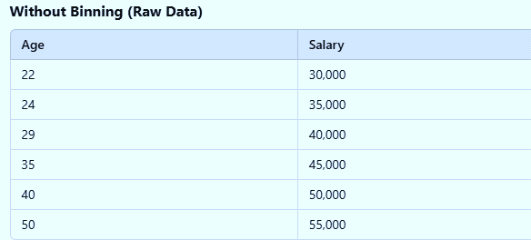

Slide 8
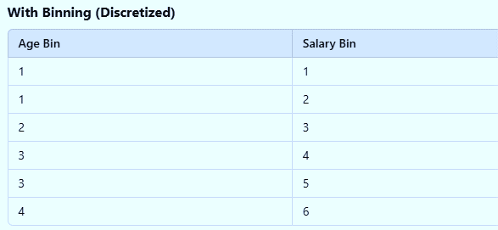

Slide 9
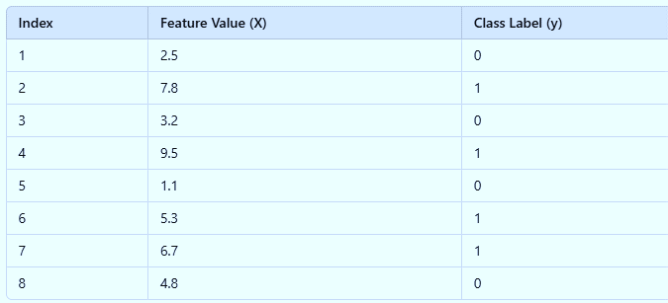
For Classification

Slide 10
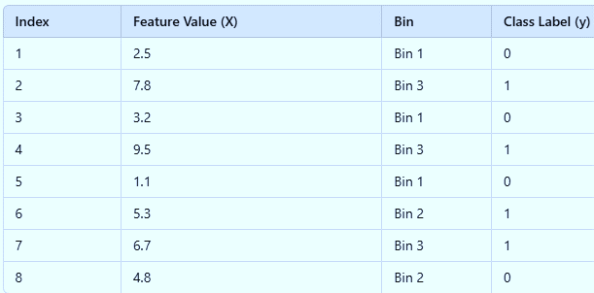
Bin 1: [0 - 3.5]
Bin 2: [3.5 - 6.5]
Bin 3: [6.5 - 10]

Slide 11
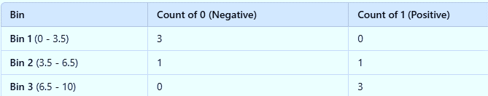
It selects the bin that maximizes information gain

Slide 12
Advantages
Faster training compared to traditional gradient boosting
Low memory consumption
Better accuracy on large datasets
Handles categorical features efficiently

Slide 13
Disadvantages
May overfit on small datasets due to aggressive tree growth
Requires careful tuning of hyperparameters for optimal performance
Less interpretable than simpler models like decision trees

Slide 14
Common Hyperparameters
num_leaves: Controls tree complexity. Higher values increase model capacity.
max_depth: Limits tree depth to prevent overfitting.
learning_rate: Controls step size during boosting.
boosting: Type of boosting (gbdt, dart, rf).
Gbdt:Gradient Boosting Decision Trees
Dart:Dropouts meet Adaptive Boosting. Uses dropout to improve generalization and avoid overfitting.
Rf: Random Forest Mode.

Slide 15
CatBoost (Categorical Boosting)
CatBoost, developed by Yandex, is a gradient boosting algorithm specialized in handling categorical features efficiently.
It is designed to work well with structured data containing categorical variables without requiring extensive preprocessing.

Slide 16
Key Features
Efficient Categorical Feature Handling: Uses ordered boosting and a unique encoding technique to process categorical variables.
Ordered Boosting: Reduces overfitting by applying permutations during training.
GPU Acceleration: Supports GPU training for speed improvement.
Robust to Missing Values: Can handle missing data seamlessly.
Works Well with Default Parameters: Requires less hyperparameter tuning compared to LightGBM and XGBoost.

Slide 17
Advantages
Excellent for datasets with categorical features
Requires minimal preprocessing (no need for one-hot encoding)
Strong generalization performance
Works well with both small and large datasets

Slide 18
Disadvantages
Slightly slower training time than LightGBM
Uses more memory compared to LightGBM
Limited hyperparameter tuning flexibility

Slide 19
Common Hyperparameters
depth: Depth of the trees (default: 6).
iterations: Number of boosting iterations.
learning_rate: Controls model update step size.
l2_leaf_reg: L2 regularization term for leaf values.
cat_features: List of categorical features.

